Slide 1
Snowball Earth
Jakob S. Kjær & Thorbjørn M. Wiinholt
Niels Bohr Instituttet
D. 21/10

Slide 2
Purpose
Investigate conditions necessary for exiting Snowball Earth
Investigate the effect of CO2
Investigate the effect of change in albedo due to volcanic ash

Slide 3
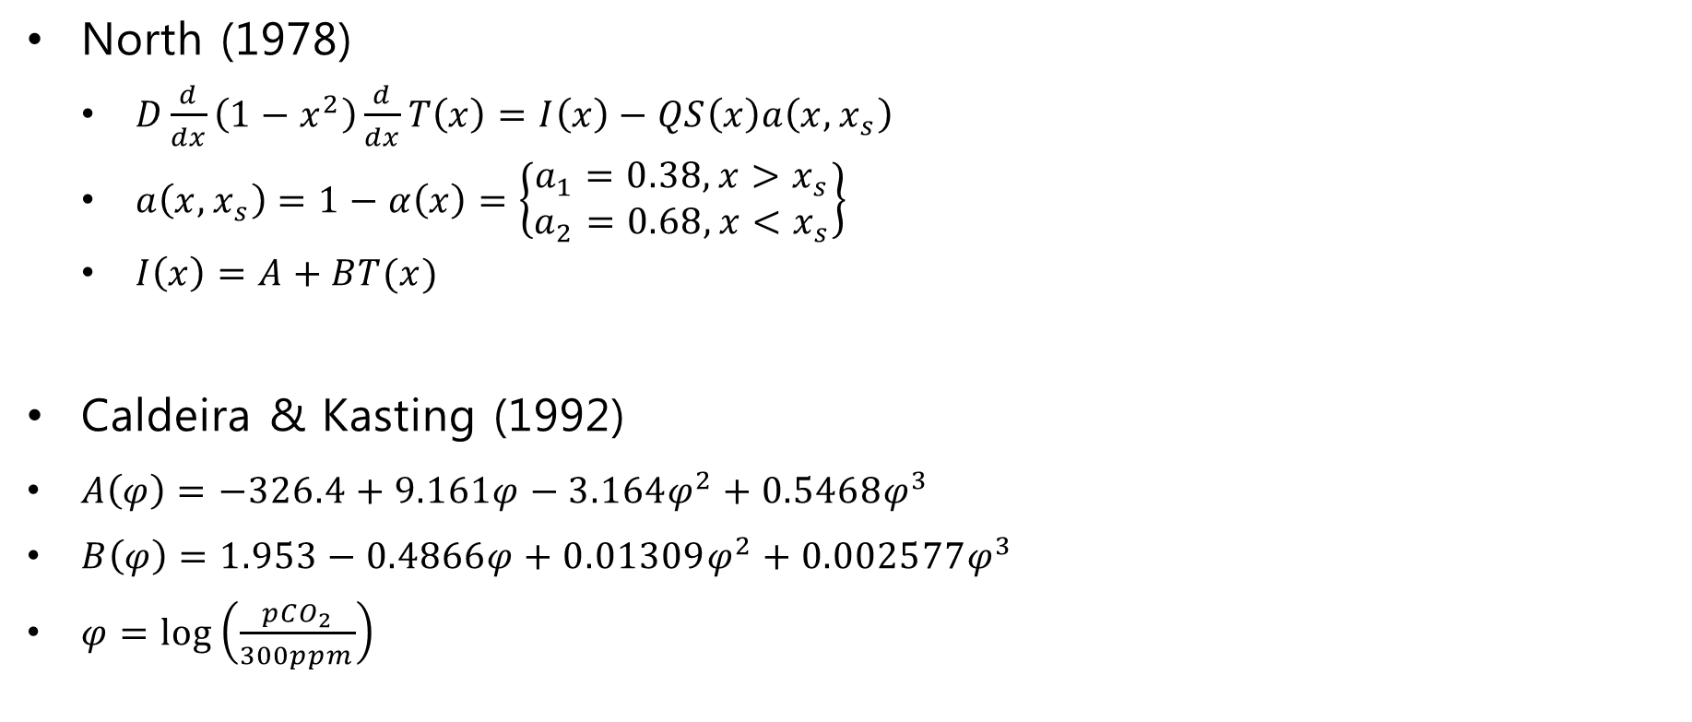
Model 1
North (1978)
$D\frac{d}{dx}\left(1−x^{2}\right)\frac{d}{dx}T\left(x\right)=I\left(x\right)−QS\left(x\right)a\left(x,x_{s}\right)$
$a\left(x,x_{s}\right)=1−α\left(x\right)=\left\{\begin{matrix}a_{1}=0.38, x>x_{s} \\ a_{2}=0.68, x<x_{s}\end{matrix}\right\}$
$I\left(x\right)=A+BT(x)$
Caldeira & Kasting (1992)
$A\left(φ\right)=−326.4+9.161φ−3.164φ^{2}+0.5468φ^{3}$
$B\left(φ\right)=1.953−0.4866φ+0.01309φ^{2}+0.002577φ^{3}$
$φ=\log\left(\frac{pCO_{2}}{300ppm}\right)$

Slide 4

Model 2
Mega volcanic eruptions
Ash layer around the earth
$α_{ice}=\left(α_{max}−α_{min}\right)⋅e^{−γc_{dust}}+α_{min}$

Slide 5
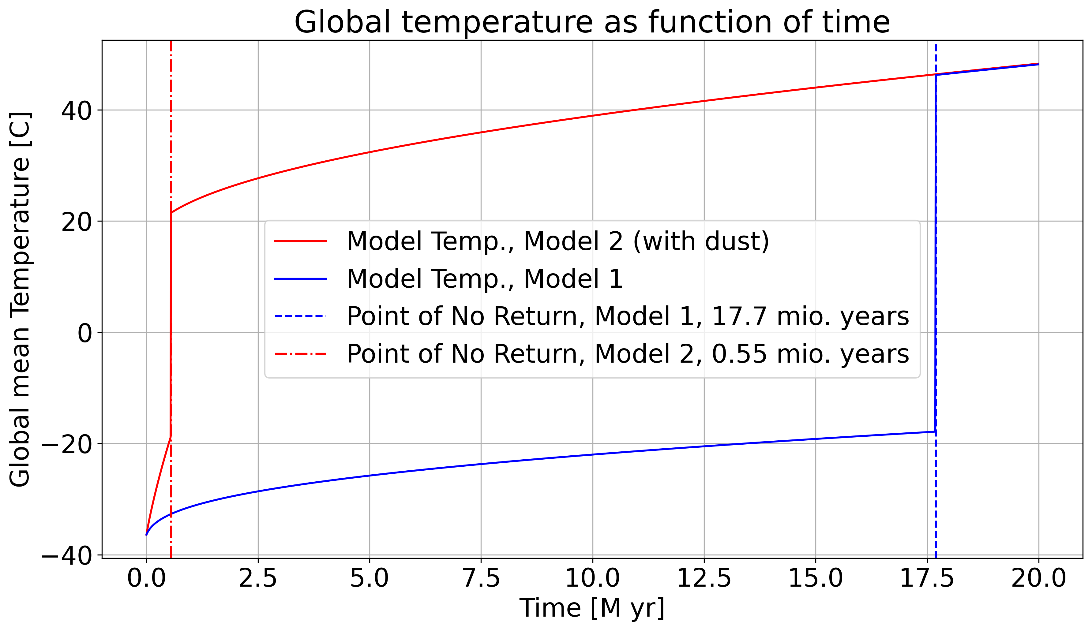
Results

Slide 6
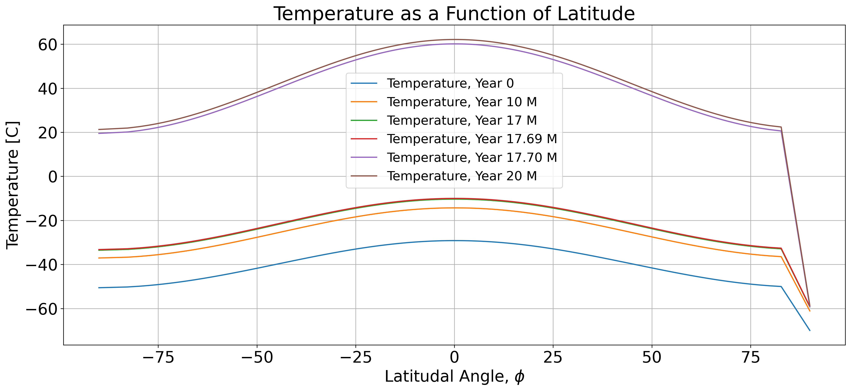
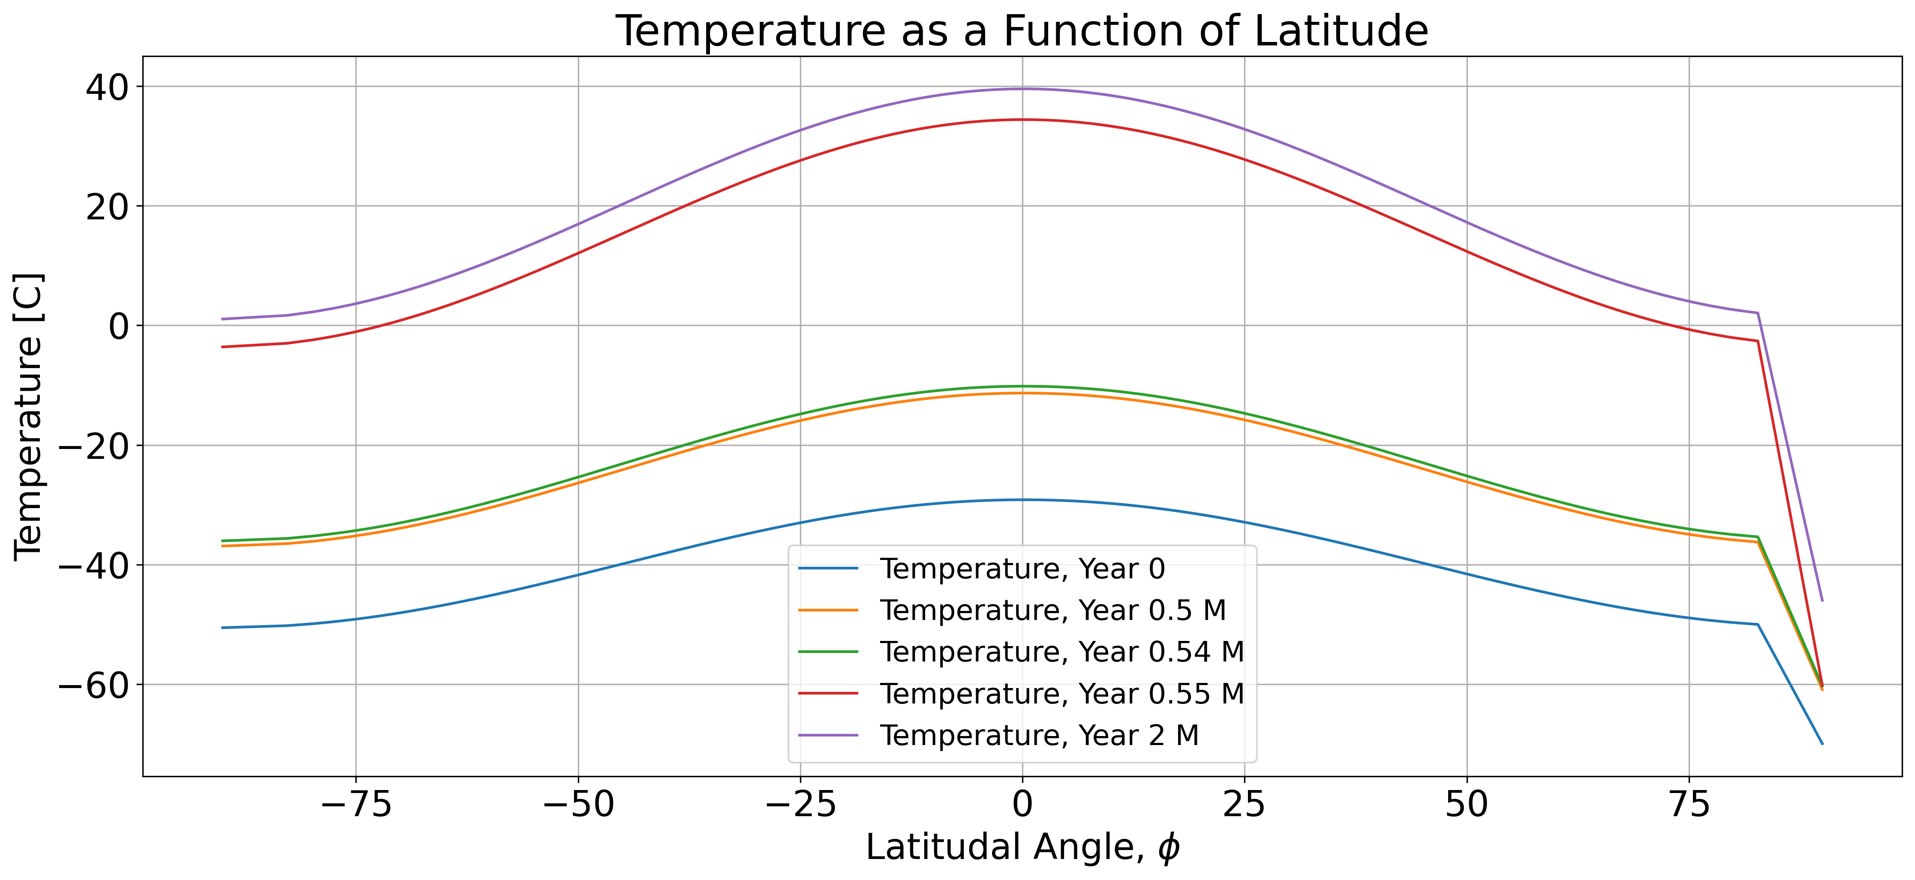
Results

Slide 7
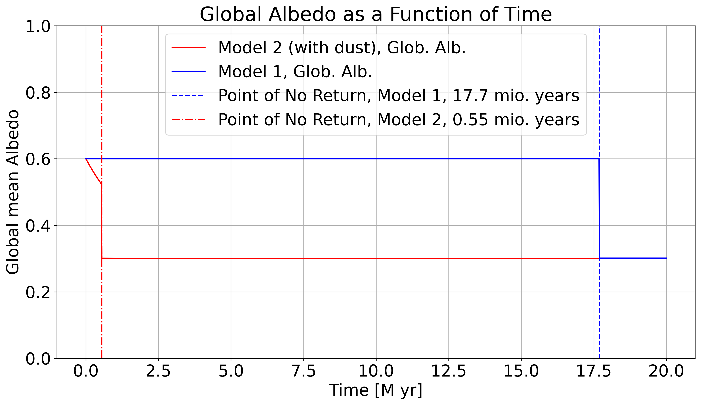
Results

Slide 8
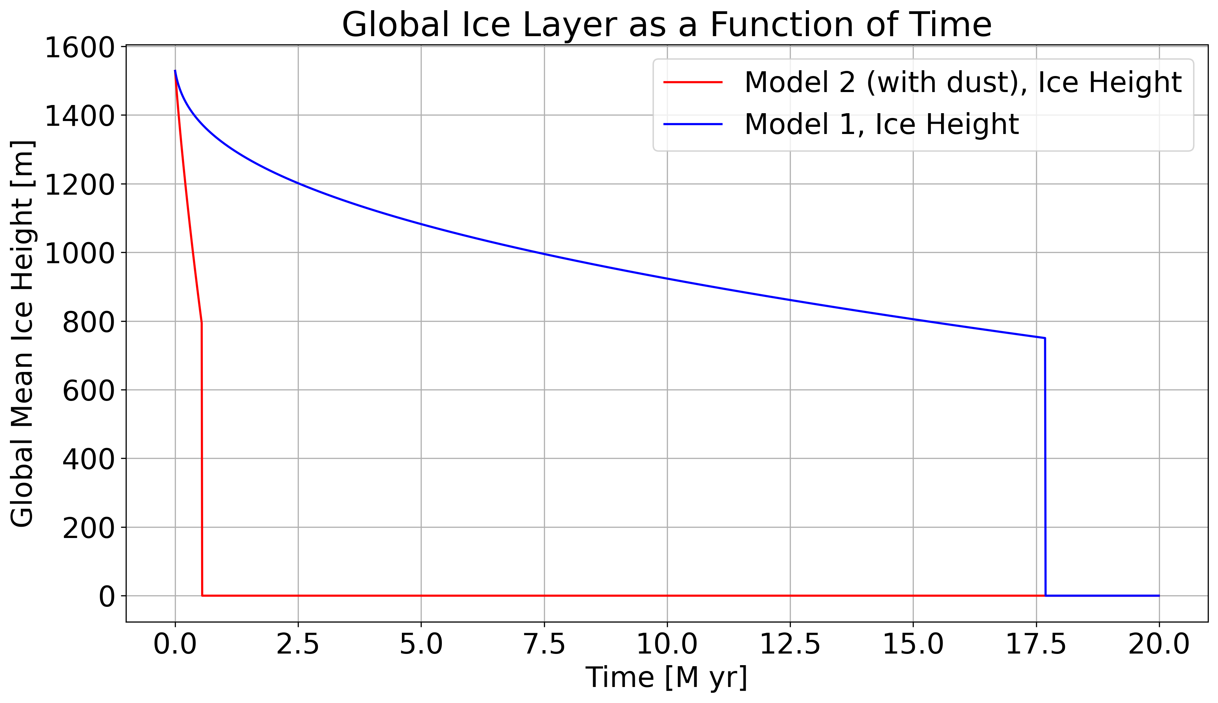
Results

Slide 9
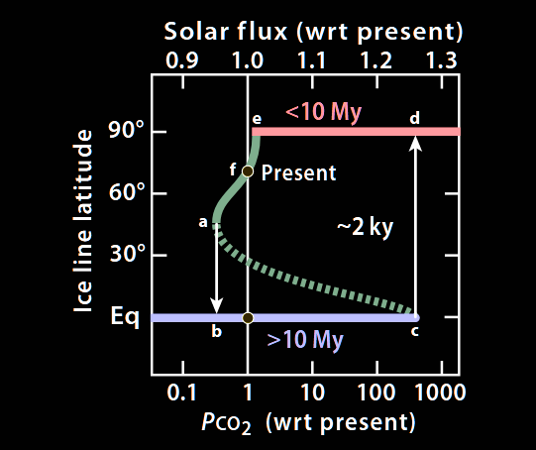
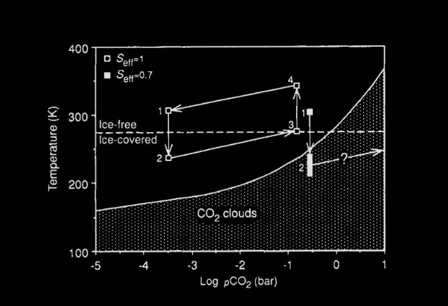
Discussion
Hoffmann et al. (2017)
Caldeira & Kasting (1992)

Slide 10
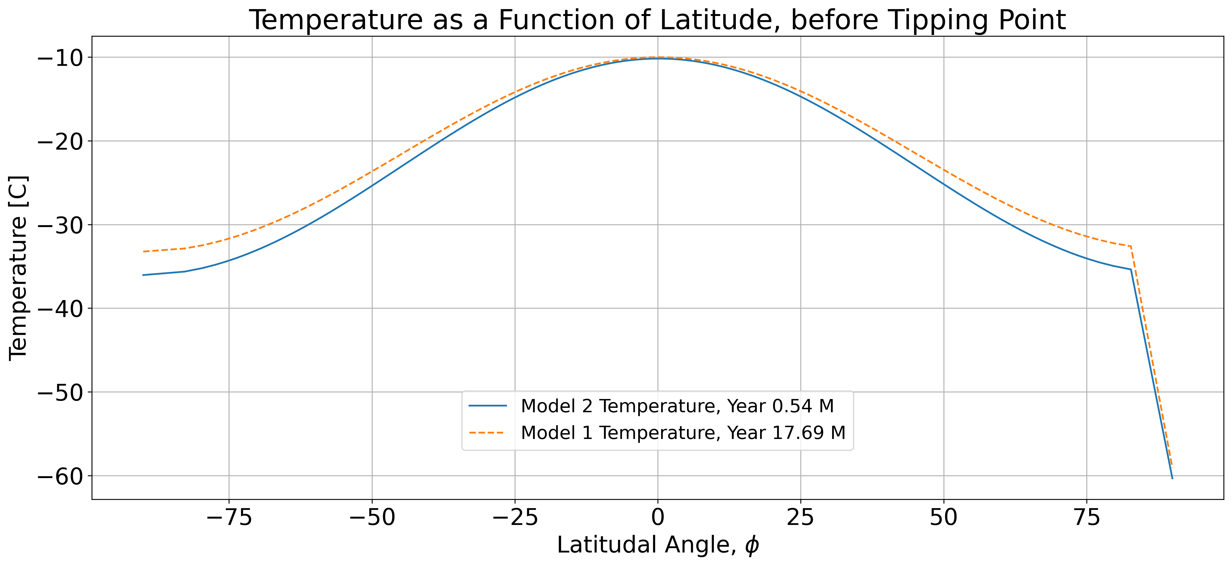
Discussion

Slide 11
Conclusion
Results agree with finding of Caldeira & Kasting (1992)
277 vs 281 times the current CO2 levels
Albedo drastically changes tipping point
Too short timescale?
Timescale due to CO2 agrees with current literature

